Slide 1

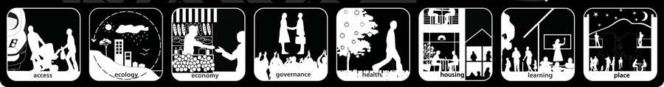
Lesson 7

Slide 2

Sea Change is the movement of people to live on the coast. As a result, coastline areas are becoming built-up and emerging as major population centres.

Slide 3
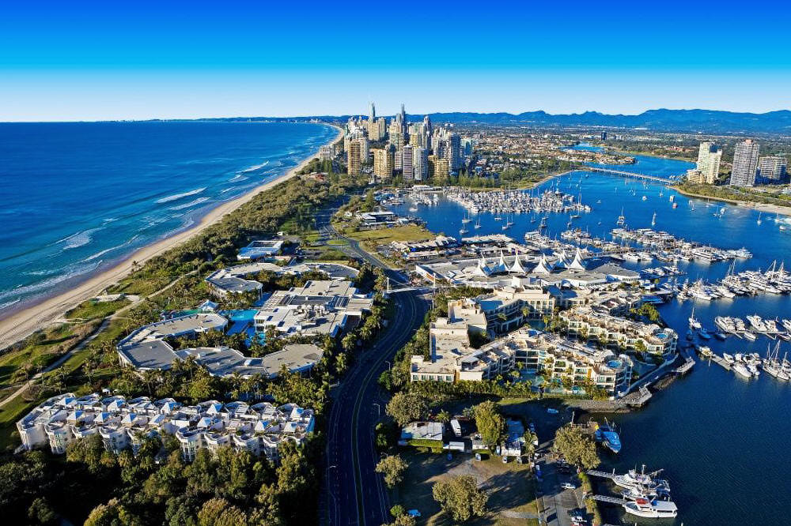
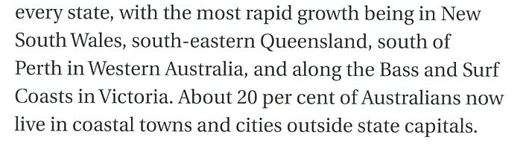
3 km wide coastal wide strip
20% of Australians live in coastal towns

Slide 4
Most rapid coastal growth in:
NSW
SE QLD
South of Perth - WA
Bass & Surf Coasts - VIC

Slide 5

Is this a problem?

Slide 6


Think!
No
Yes
Share

Slide 7
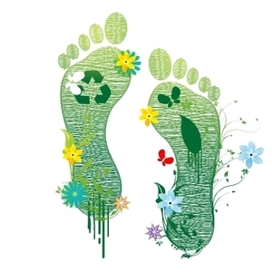
Destroyed dunes
Damaged wetlands
Polluted water
Impact on coastal species

Slide 8
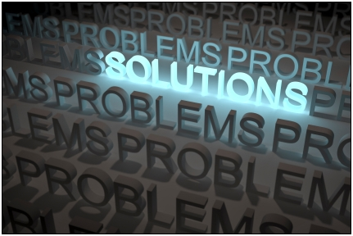

Who?
Why?
When?
http://www.seachangetaskforce.org.au/Home.html

Slide 9
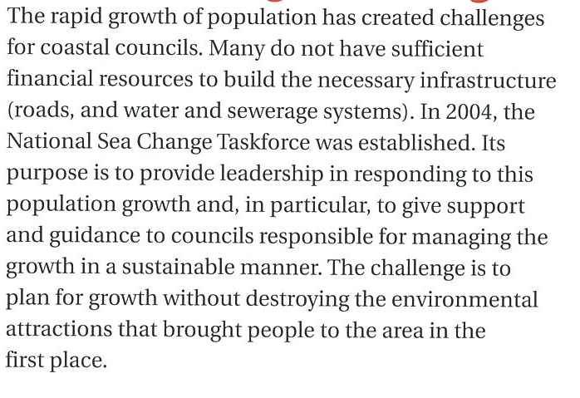

Slide 10


Create a persuasive poster:
Future coastal development should be limited as it is too damaging to the environment.
Future coastal development should not be limited as it is not too damaging to the environment.

